Slide 1
Simulation of Light Scattering and Propagation ― Final Project
Prediction of The Stock Price
P
R
O
F
I
T
I
L
O
S
S
K
Professor: Dr. Snow H. Tseng
Members:
吳天予 Tammy、潘如麟 Jason、陳政霆 Leon、 DEEPALI SINHA
3

Slide 2
Outline
01
Motivation
02
Introduction
03
Method
04
Results & Discussion
P
R
O
F
I
T
I
L
O
S
S
05
Reference
K
2

Slide 3
Motivation
WHY WE NEED THIS SIMULATION?
Predict the stock price of next second
Understand the impact of risk and uncertainty of the market
BUY
Losing money in stock market
Finding out a way to predict the stock price of next second
Avoid losing money and get rich
SELL
3
Notes:
People often lose money in the stock market, so they are eager to predict future trends to avoid investment losses and make money. Therefore, it is very important to be able to accurately simulate the future stock market.

Slide 4



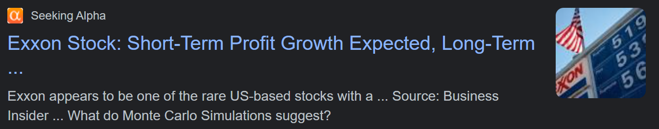
Examples of Monte Carlo Simulation Prediction of Stock Prices
Monte Carlo is widely used in the financial world to predict commodity and stock prices
It Works!
Financial News Example
4
Notes:
There are lots of Examples of Monte Carlo Simulation Prediction of Stock Prices . The Monte Carlo method is used to predict the future stock prices of companies such as Starbucks, Disney, and Nokia. This shows that it has very practical commercial application value

Slide 5
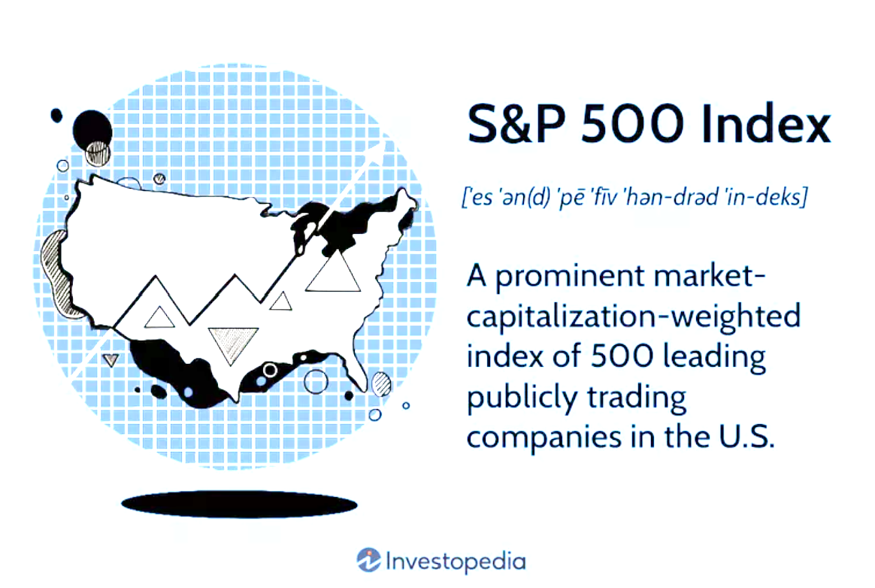

The Goal of this Project
Method
To Predict the S&P 500 Price For the Next Few Years
Goal
To simulate a basic Brownian motion of particles suspended in a medium.
Using Brownian Motion to predict the stock price.
Compare results with Monte Carlo simulation.
BUY
BUY
SELL
SELL
5
Notes:
The Goal of this Project is to Predict the S&P 500 Price For the Next Few Years. The S&P 500 is a stock market index that is viewed as a measure of how well the stock market is performing overall. It includes around 500 of the largest U.S. companies.

Slide 6
Method
How We Predict The Stock Price ?
Brownian motion simulation (BGM)
Monte Carlo simulation
Predict the stock price of next second
Current Market Condition
5
Notes:
We use the price changes of S&P500 in the past ten years to first calculate the financial parameters, and use the price of this file etf on 2022/12/09 as the starting price to start simulating the price in the next five years, using Monte Carlo and Brownian motion simulation Two ways to simulate

Slide 7

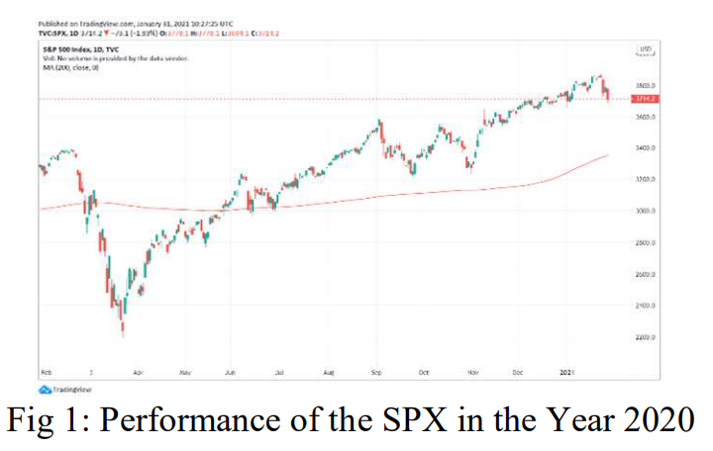

Method
Current Market Condition
Aims to forecast future trends of the SPX500
Collect a large amount of historical stock data
Analyzing the historical price patterns
(Using the Monte Carlo Simulation and GBM model)
7
Notes:
Our project investigates the statistics of market volatility by obtaining and analysing data sources from financial websites using Python programming language.

Slide 8
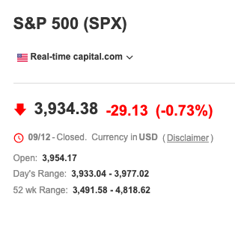
Method
Market Parameter
µ and σ need to be considering the stock price value of past few years.
Data extraction from 2012/12/09 to 2022/12/09
µ = expected daily return; σ = daily price change
Initial price = 3934.38
8
Notes:
All data comes from this website:
https://www.investing.com/indices/us-spx-500-historical-data
In stock price simulation, we focus on two important constant: µ and σ
µ is drift, which represents the expected daily return
σ is shock, which represents the daily price change

Slide 9
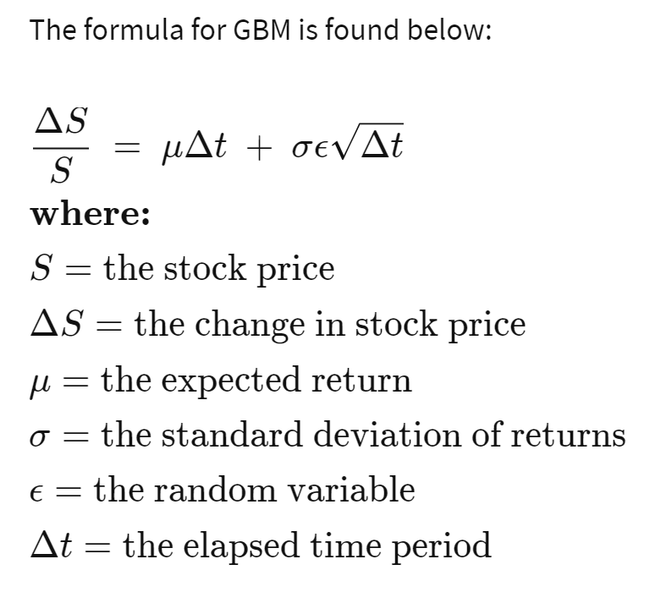
Method
Geometric Brownian Motion (GBM)
Specify a Model (Geometric Brownian Motion (GBM))
The stock price follows a random walk
Consistent with the weak form of the efficient market hypothesis (EMH)
Past price information
Conditionally
Independent
Next price movement
9
Notes:
1. Specify a Model (e.g. GBM)
we will use the geometric Brownian motion (GBM), which is technically a Markov process. This means the stock price follows a random walk and is consistent with (at the very least) the weak form of the efficient market hypothesis (EMH)—past price information is already incorporated, and the next price movement is "conditionally independent" of past price movements.
The formula for GBM is found below: ΔS​ = μΔt + σϵΔt ​where: S=the stock price ΔS=the change in stock price μ=the expected return σ=the standard deviation of returns ϵ=the random variable Δt=the elapsed time period​

Slide 10
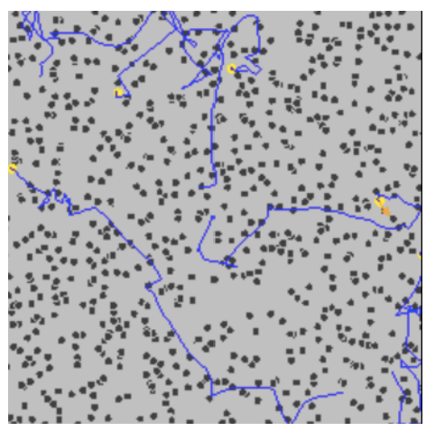
Method
Geometric Brownian Motion(GBM)
Brownian motion simulation
Expectation value of Brownian motion and the random process of stock price are independent
Brownian motion only considers positive value like stock market
The calculation of Brownian motion is simpler than other complicated method
Figure 2 To simulate a basic brownian motion of particles suspended in a medium
10

Slide 11
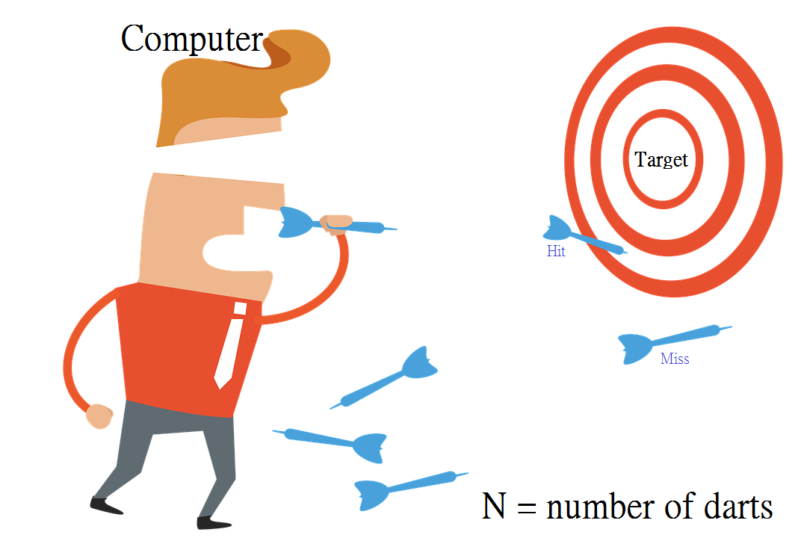
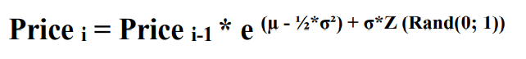
Method
Monte Carlo Simulations
Applicable Situation
Monte Carlo concept
Monte Carlo Simulation can be made use for predicting share price movements
The past share prices exhibit random behavior
Without exhibiting high fluctuations
Repeated random sampling
Obtain numerical results
Monte Carlo Simulations will be performed according to the formula:
11

Slide 12
RESULTS
Simple Presentation
12

Slide 13
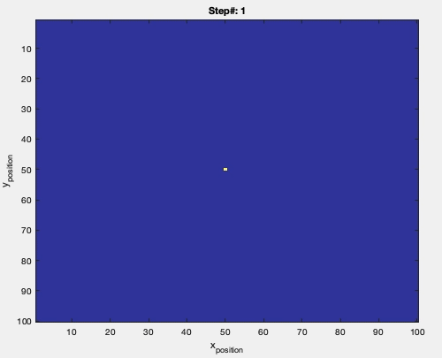
Results
Brownian motion of particles
13

Slide 14
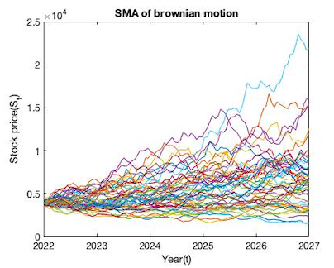
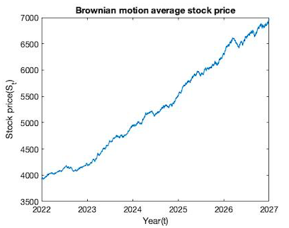
Results
Geometric Brownian Motion of SPX500 Prediction
We predict the stock price of the S&P 500 for the next five years
Fig. 3 (a) Geometric Brownian Motion of SPX500 Prediction
Fig. 3 (b) Geometric Brownian Motion of SPX500 average stock price
14
Notes:
Simulation parameters:
Initial price: 3934.38
Random sampling: 1000000 times
Repeat it for 50times

Slide 15
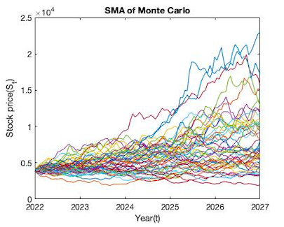
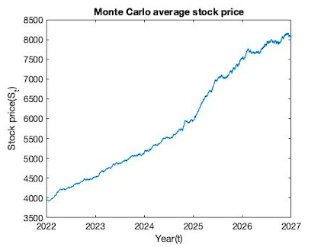
Results
Monte Carlo of SPX500 Prediction
We predict the stock price of the S&P 500 for the next five years
Fig. 4 (a) Monte Carlo of SPX500 Prediction
Fig. 4 (b) Monte Carlo of SPX500 average stock price
15
Notes:
Simulation parameters:
Initial price: 3934.38
Random sampling: 1000000 times

Slide 16
Discussion
The Difference Between Two Method
Method | Rise | MAX - MIN
Brownian Motion | 70.5 % | 2836
Monte Carlo | 75.2 % | 3435
Monte Carlo method tends to exist a higher prediction value due to the formula(exponential function)
Monte Carlo method has a higher variation among different trials.
16

Slide 17
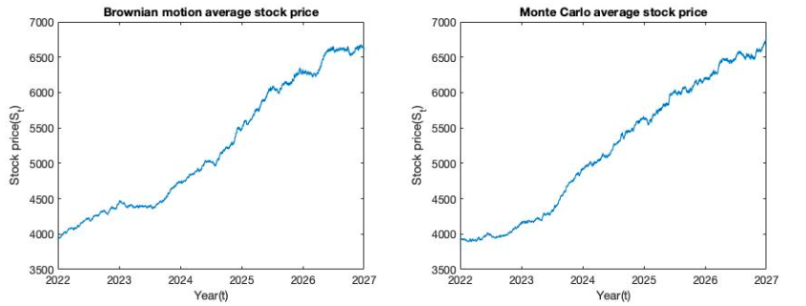
Discussion
Between Two Method
Fig. 5 Two method prediction of average stock price. (a) Geometric Brownian Motion of SPX500 average stock price
(b) Monte Carlo of SPX500 average stock price
17
Notes:
Two methods share "same" characteristic
1. Around 2023-2024, there's a rapid rise.
2. Price goes up between 2024~2026.
3. At 2026-2027, there's a rapid rise again.

Slide 18
Conclusion
Although the simulation algorithms are different, they share a similar simulation result!
After 5 years, the stock price of S&P500 is expected to be 7000
18

Slide 19


Challenges
The distribution be assumed normal
Unpredictable sudden international situation
19

Slide 20
Reference
Xiang, J. N. P., Velu, S. R., & Zygiaris, S. (2021, December). Monte Carlo Simulation Prediction of Stock Prices. In 2021 14th International Conference on Developments in eSystems Engineering (DeSE) (pp. 212-216). IEEE.
https://www.investopedia.com/articles/07/montecarlo.asp
https://en.wikipedia.org/wiki/Brownian_motion
https://en.wikipedia.org/wiki/Monte_Carlo_method
20

Slide 21
P
R
O
F
I
T
I
THANK YOU
L
O
S
S
K

